Slide 1
CS 367-305/306/307
Recitation 11 – Caching

Slide 2
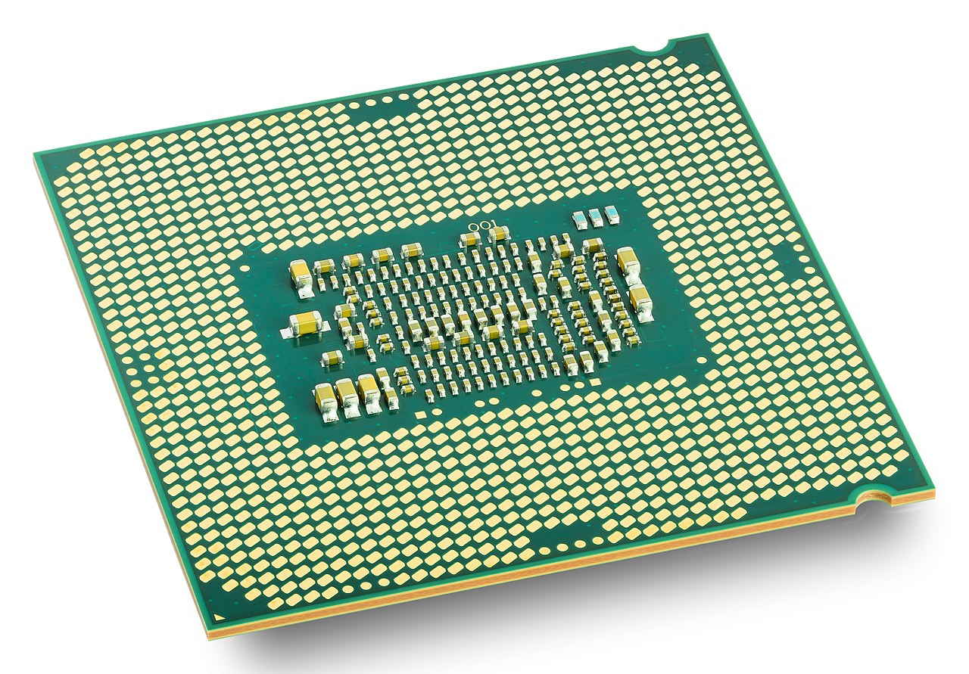
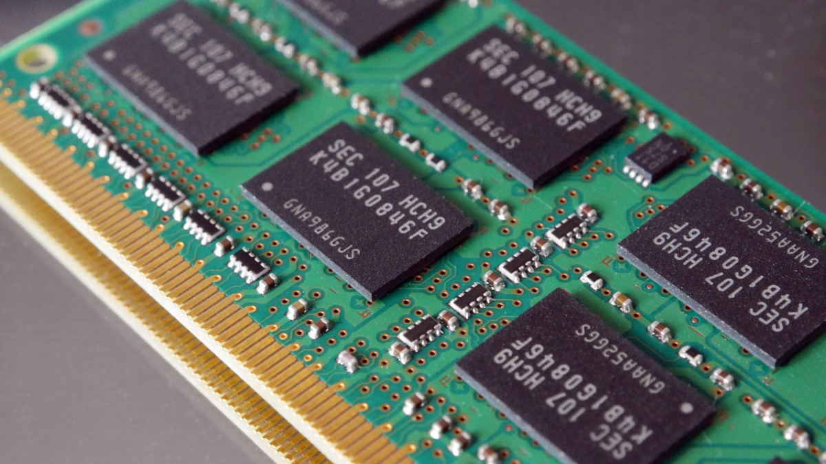
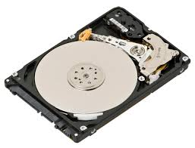
How Computers Are Supposed To Work
How Computers Actually Work
Memory
HDD/SSD
CPUs
MAGIC
Bus
Bus

Slide 3
How Computers Actually Work
Memory
HDD/SSD
CPUs
Bus
Bus

Slide 4
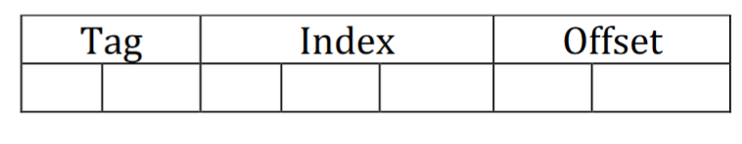
Caching Rules
When accessing an address:
First, try retrieving the data from cache
Decompose the address to Tag | Index | Offset

Slide 5
Caching Rules
When accessing an address:
First, try retrieving the data from cache
Decompose the address to Tag | Index | Offset
Go to the Index in the cache table, check existing tag(s)
Is there a match? Is the match valid?
This is a hit! Return data at the offset. For LRU, update the timestamp.

Slide 6
Caching Rules
When accessing an address:
First, try retrieving the data from cache
Decompose the address to Tag | Index | Offset
Go to the Index in the cache table, check existing tag(s)
Is there a match? Is the match valid?
This is a hit! Return data at the offset. For LRU, update the timestamp.
Otherwise, retrieve the data from memory and update the cache
Return the byte at the address
UPDATE THE CACHE BLOCK
For LRU, pick invalid blocks as a victim first, then older blocks

Slide 7
Caching Rules
When accessing an address:
First, try retrieving the data from cache
Decompose the address to Tag | Index | Offset
Go to the Index in the cache table, check existing tag(s)
Is there a match? Is the match valid?
This is a hit! Return data at the offset. For LRU, update the timestamp.
Otherwise, retrieve the data from memory and update the cache
Return the byte at the address
UPDATE THE CACHE BLOCK
For LRU, pick invalid blocks as a victim first, then older blocks
MAKE SURE TO UPDATE THE CACHE.
FUTURE ANSWERS DEPEND ON UPDATES

Slide 8
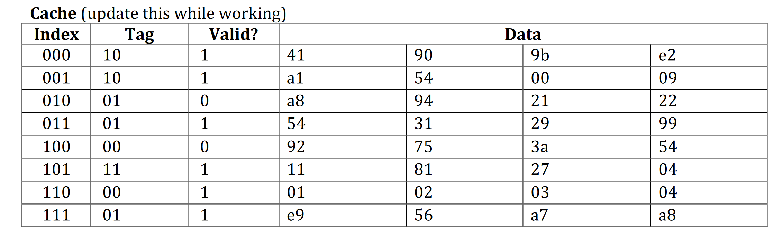
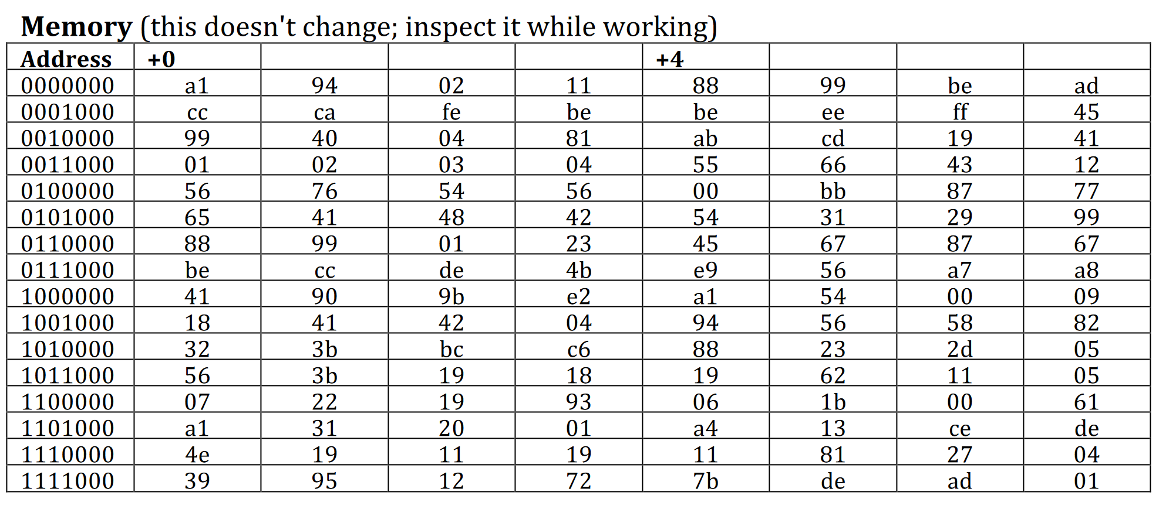
Caching Example
Address: 10 001 01
Hit:
Data Returned:
Changes:
Address: 10 111 01
Hit:
Data Returned:
Changes:
+0 00 | +0 01 | +0 10 | +0 11 | +1 00 | +1 01 | +1 10 | +1 11

Slide 9
Caching Example
Address: 10 001 01
Hit:
Data Returned:
Changes:
Address: 10 111 01
Hit:
Data Returned:
Changes:
+0 00 | +0 01 | +0 10 | +0 11 | +1 00 | +1 01 | +1 10 | +1 11

Slide 10
Caching Example
Address: 10 001 01
Hit: Yes
Data Returned: 54
Changes: none
Address: 10 111 01
Hit:
Data Returned:
Changes:
+0 00 | +0 01 | +0 10 | +0 11 | +1 00 | +1 01 | +1 10 | +1 11

Slide 11
Caching Example
Address: 10 001 01
Hit: Yes
Data Returned: 54
Changes: none
Address: 10 111 01
Hit:
Data Returned:
Changes:
+0 00 | +0 01 | +0 10 | +0 11 | +1 00 | +1 01 | +1 10 | +1 11

Slide 12
Caching Example
Address: 10 001 01
Hit: Yes
Data Returned: 54
Changes: none
Address: 10 111 01
Hit: Miss, wrong tag
Data Returned:
Changes:
+0 00 | +0 01 | +0 10 | +0 11 | +1 00 | +1 01 | +1 10 | +1 11

Slide 13
Caching Example
Address: 10 001 01
Hit: Yes
Data Returned: 54
Changes: none
Address: 10 111 01
Hit: Miss, wrong tag
Data Returned:
Changes:
+0 00 | +0 01 | +0 10 | +0 11 | +1 00 | +1 01 | +1 10 | +1 11

Slide 14
Caching Example
Address: 10 001 01
Hit: Yes
Data Returned: 54
Changes: none
Address: 10 111 01
Hit: Miss, wrong tag
Data Returned: 62
Changes:
+0 00 | +0 01 | +0 10 | +0 11 | +1 00 | +1 01 | +1 10 | +1 11

Slide 15
Caching Example
Address: 10 001 01
Hit: Yes
Data Returned: 54
Changes: none
Address: 10 111 01
Hit: Miss, wrong tag
Data Returned: 62
Changes:
- Copy 4 bytes from 10 111 00
UPDATE THE CACHE
10
19
62
11
05
+0 00 | +0 01 | +0 10 | +0 11 | +1 00 | +1 01 | +1 10 | +1 11

